Slide 1
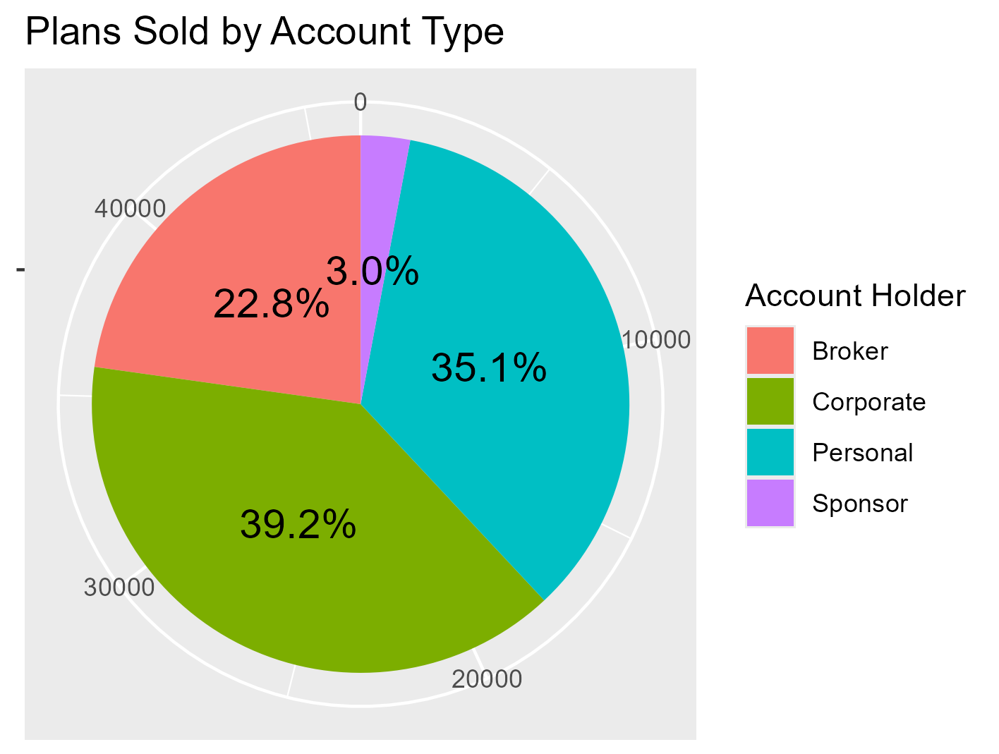
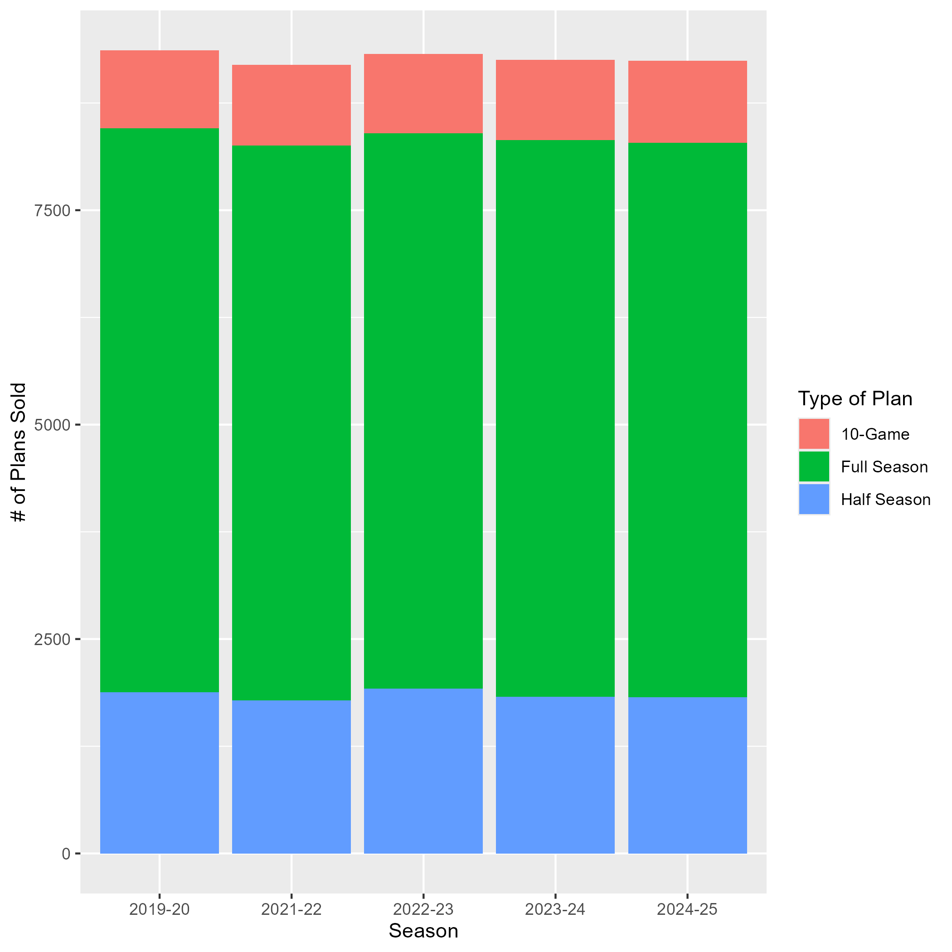
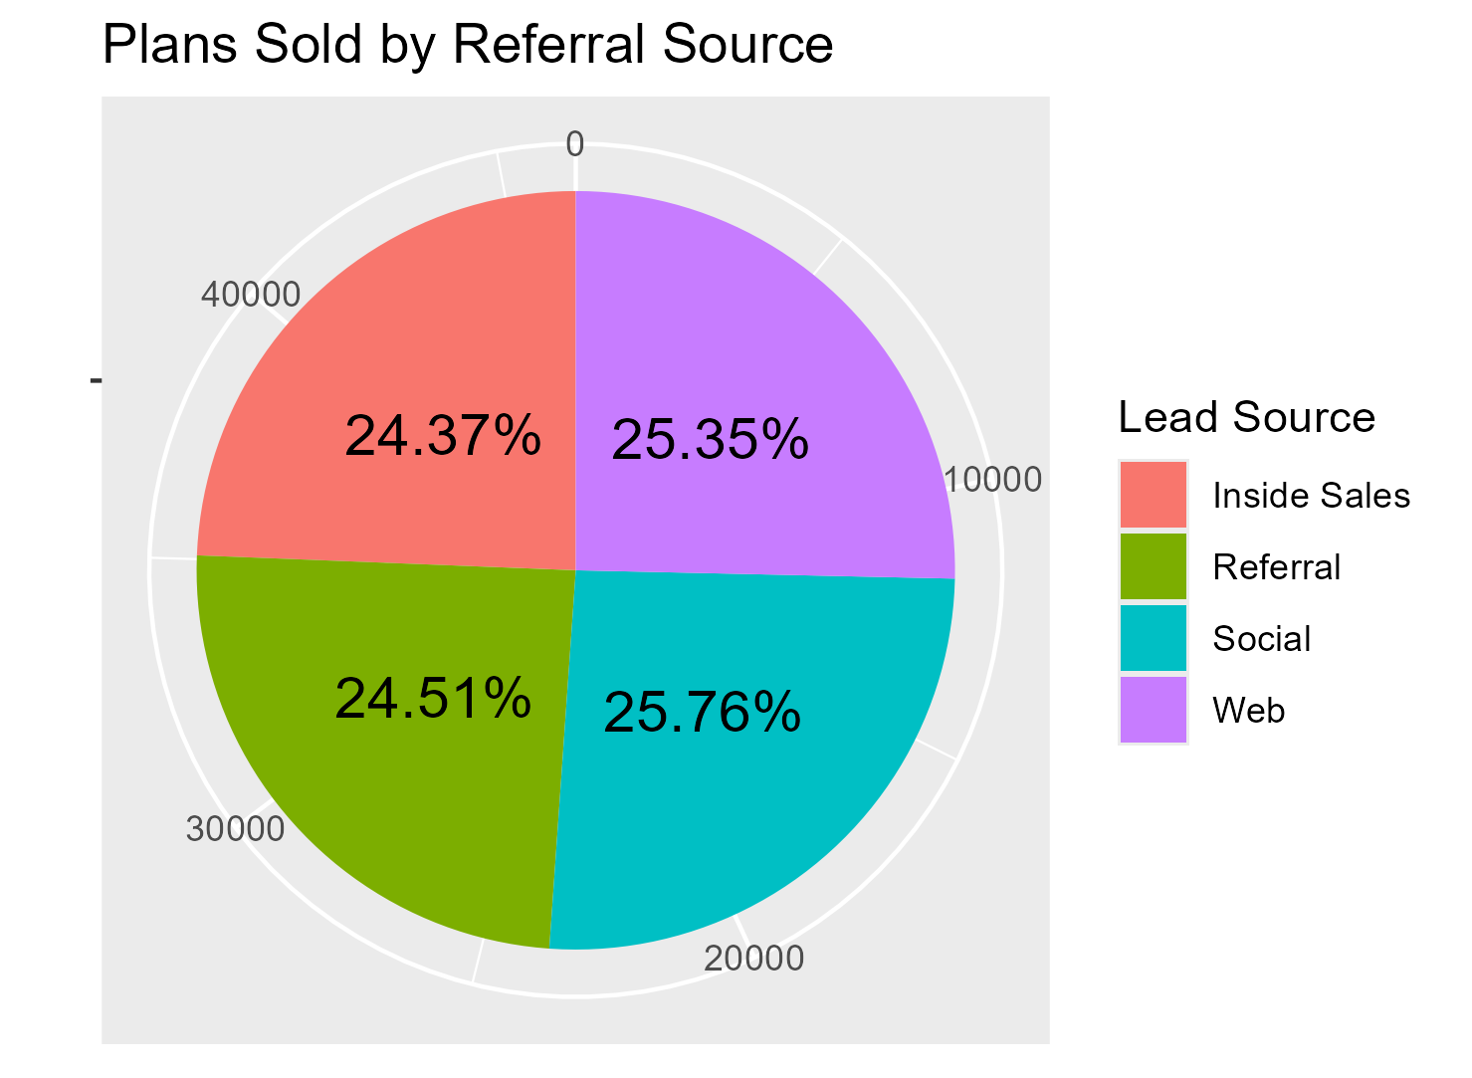
Initial Data Exploration: What are Our Fans Purchasing and How?
Most Season Ticket Plans sold to corporate partners and personal purchases
Nearly ¼ of plans purchased through a broker
Nearly equal split in source of ticket purchase
Suggests that marketing team does not excel in one specific area
Little to no variation across seasons
Bulk of ticket plans are Full Season
No trends suggesting Half-Season/10 Game plans are increasing in popularity

Slide 2
Seating Selection: Where are Our Fans Sitting and What are They Paying?
Top-Profiting Sections by Arena Level
(On Average)
Floor Level
Lower Bowl
Upper Bowl
Section | Subsection | Avg. Price | Plans Sold | Total Sales
20 | Sideline | $1,803.65 | 43 | $77,557
13 | Sideline | $1,565.27 | 49 | $76,698
10 | Baseline | $1,579.62 | 45 | $71,083
Section | Subsection | Avg. Price | Plans Sold | Total Sales
104 | Sideline | $304.55 | 814 | $247,910
102 | Baseline | $300.37 | 817 | $245,406
109 | Sideline | $303.60 | 804 | $244,094
Section | Subsection | Avg. Price | Plans Sold | Total Sales
217 | Sideline | $80.52 | 1,068 | $85,998
214 | Sideline | $78.93 | 1,076 | $84,926
212 | Sideline | $79.55 | 1,052 | $83,686
Takeaways
Slight preference for seats on sidelines
Lower bowl much larger source of income than other areas
Mixture of quality + quantity
Not much variation regarding top selling sections in upper bowl
All priced and selling at similar levels

Slide 3
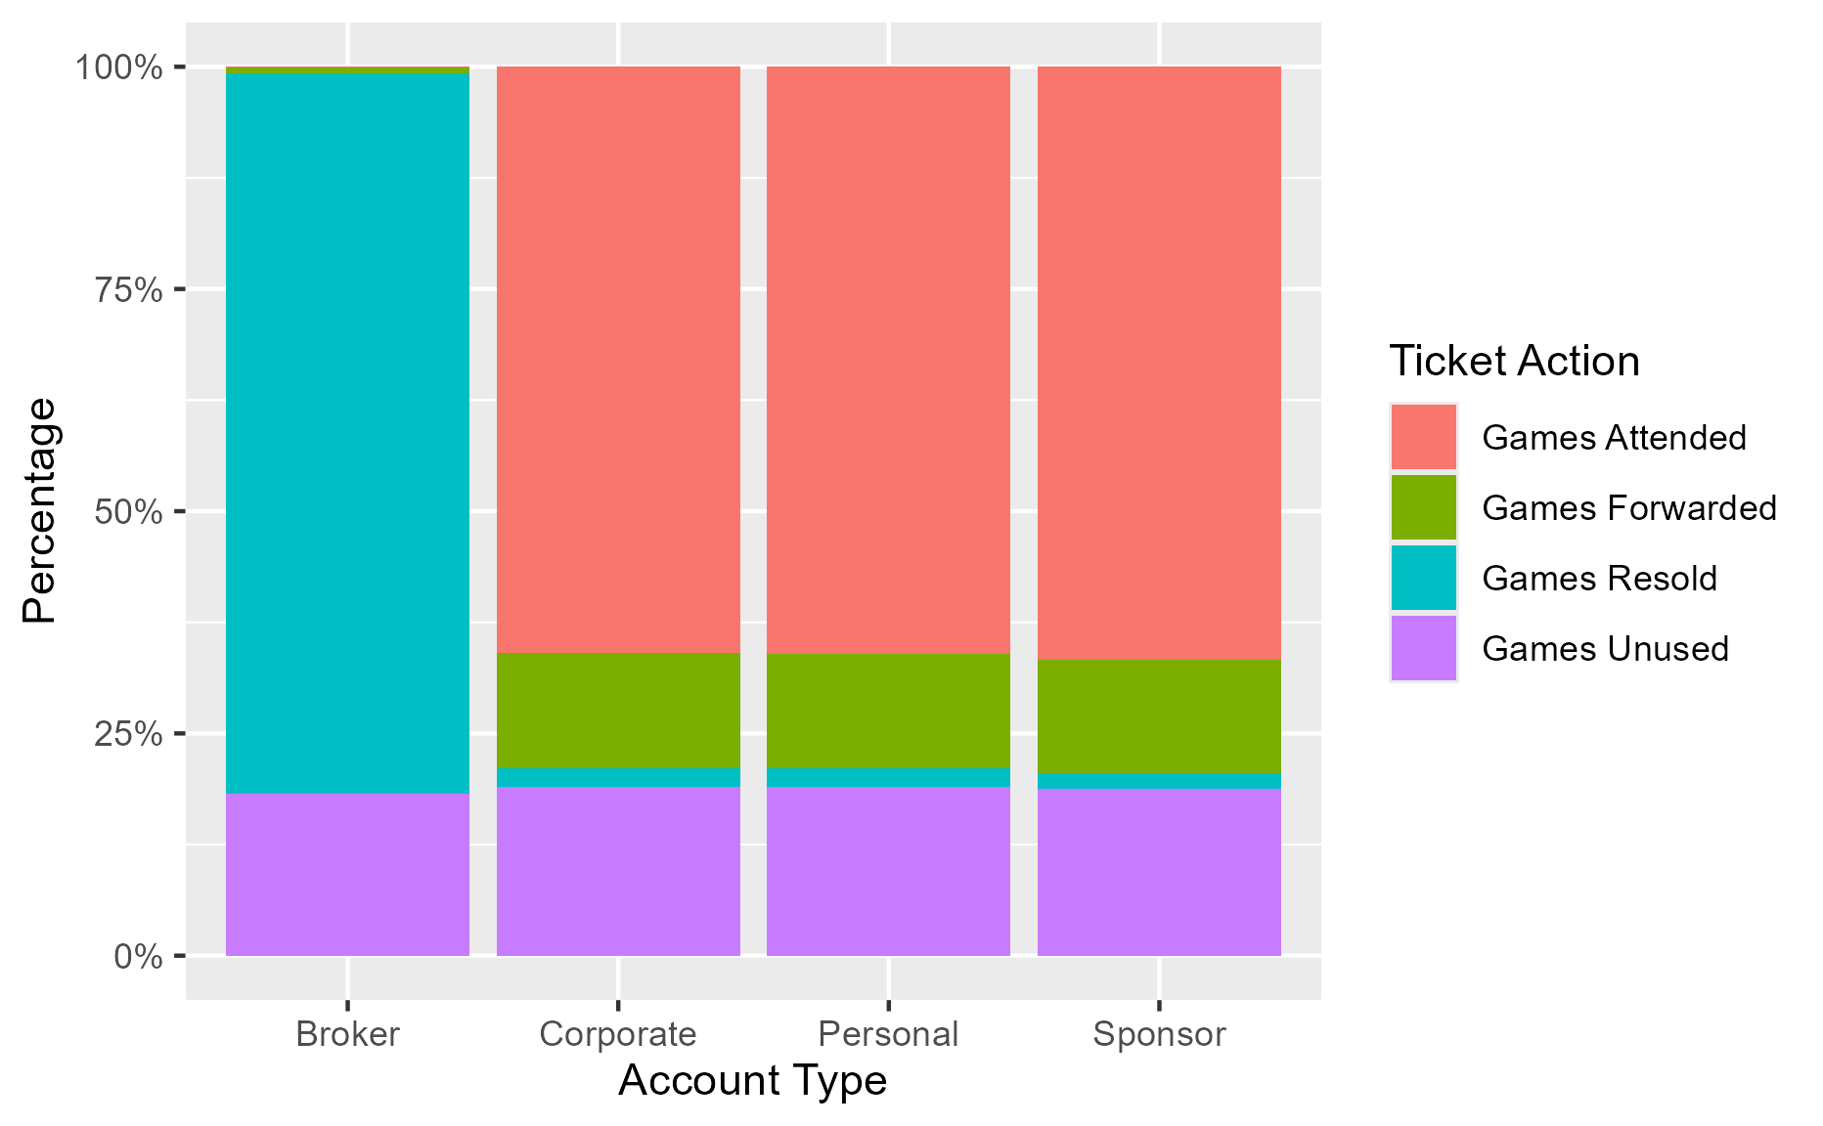
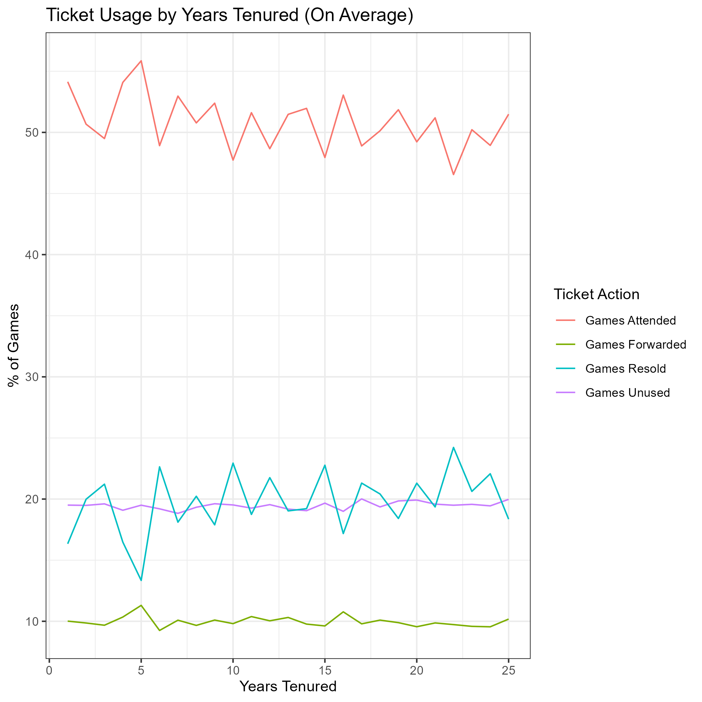
Buyer Behavior What are Our Fans Doing with their Tickets?
Abnormal variation as tenure increases for Attended and Resold games
Slight trend suggests longer tenured customers attending less games
Unused and Forwarded games behavior stays consistent
Corporate, Personal, and Sponsor breakdown all very similar
Broker resells most games, but # of games unused stays the same
Fan behavior is similar regardless of who is buying

